Slide 1
Integrated Geophysical Method for Levee Safety Assessment
The Use of Geophysical Imaging for Dam and Levee Assessment,
Sep. 15, 2016, Philadelphia, PA.
Koichi Hayashi*, OYO Corporation/Geometrics
Tomio Inazaki, PWRI Tsukuba Central Institute
Mitchell Craig, CSU East Bay
Recep Cakir, Washington State Department of Natural Resources
Juan Lorenzo, Louisiana State University
SEGJ Levee Consortium, Society of Exploration Geophysicists of Japan

Slide 2
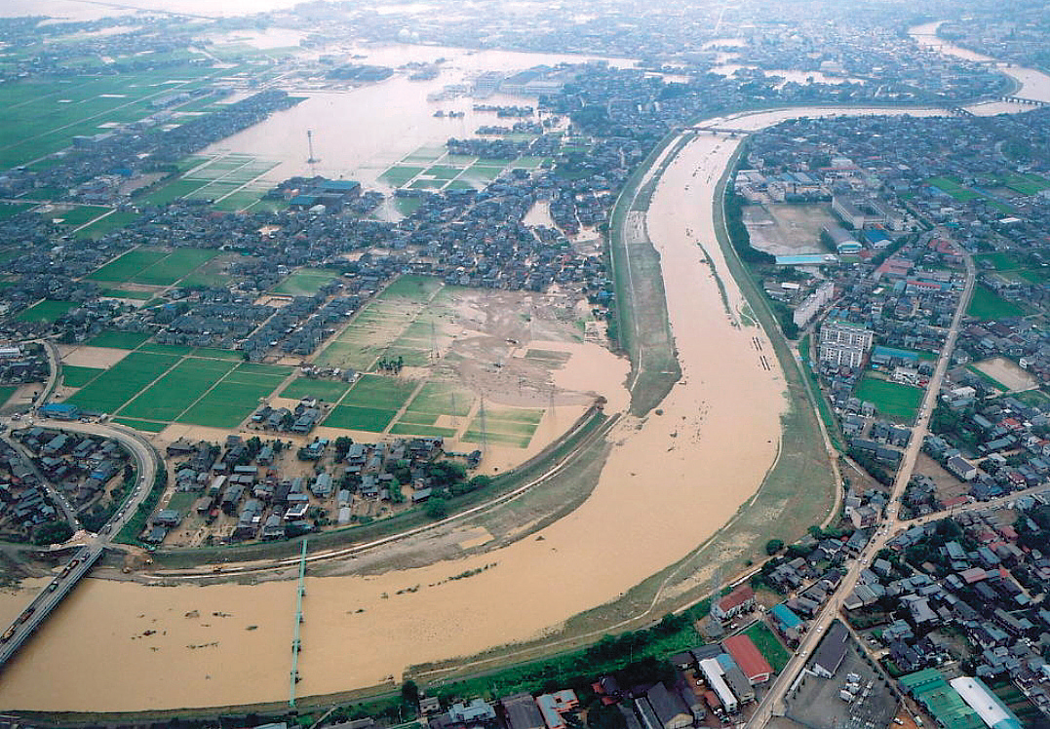
Flood control along a river
Boring
Boring
04JUL13, 2004
Niigata Flooding by Torrential Rainfall
Boring
Notes:
Let me think about flood control along a river.
River is long continuous object.
Of course, we cannot perform the boring continuously.
However, levee breaks at some particularly place. In order to evaluate the levee continuously, we have to combine different methods together, Boring, Laboratory tests, and Geophysical methods. This is a very important concept of the integrated geophysical methods.

Slide 3
What is the Integrated Geophysical Methods?
Several different geophysical methods are used together
Geotechnical or geological investigation results are combined with geophysical results
Different sets of information with a variety of resolutions and dimensions are combined
Engineering parameters are estimated from geophysical properties
Change the analysis from qualitative to quantitative
Notes:
What is the integrated geophysical methods?
This is the summary.
Several different geophysical methods are used together.
Geotechnical or geological investigation results are combined with geophysical results.
Different sets of information with a variety of resolutions and dimensions are combined.
Engineering properties are estimated from geophysical properties.
Change the analysis from qualitative to quantitative.

Slide 4
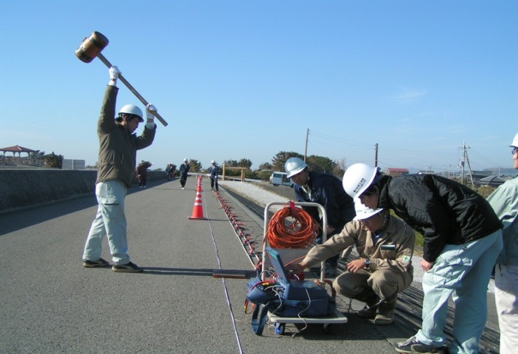
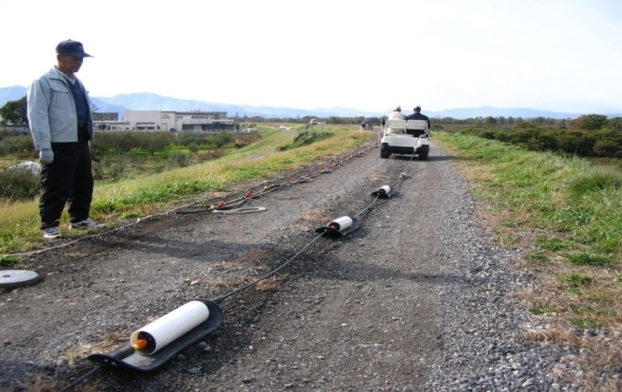
Data acquisition
Capacitively-coupled resistivity survey
Surface wave survey
Notes:
We applied a surface wave method using a land-streamer.
And a capacitively coupled resistivity. We applied two methods to 160km of levee and total length of geophysical survey was 320km.

Slide 5
Why do we need several different geophysical methods ?
○：Good relationship
△: Some relationship
×: No relationship
Typical engineering parameters | Geophysical properties
 | P-velocity | S-velocity | Resistivity
Groundwater level | ○ | × | △
Stiffness | △ | ○ | ×
Soil type | △ | △ | △
Permeability | × | △ | △
Notes:
This is an example of integrated geophysical method in levee investigation. This is a reservoir and this is a levee. Survey line length is 450m.
The levee looks like as this photo.
The engineering purposes of this investigation are groundwater level, stiffness of soil, such as hard or soft, and soil type, such as sand, clay or gravel. How can we estimate these values from geophysical data?
For example, P-wave velocity is sensitive to ground water, but there is no direct relationship to stiffness and soil type. S-wave velocity has direct relationship to the stiffness of soil, but no relationship to groundwater. Resistivity has no relationship to stiffness and some relationship to groundwater and soil type. But these relationships are not direct. Clearly, one geophysical method is not enough for this project. We have to combine several methods together. This is a basic concept of the integrated geophysical method.

Slide 6
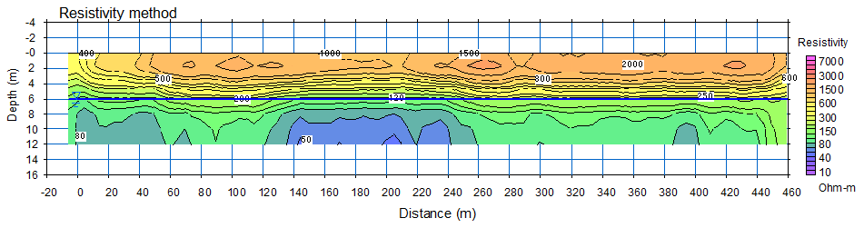
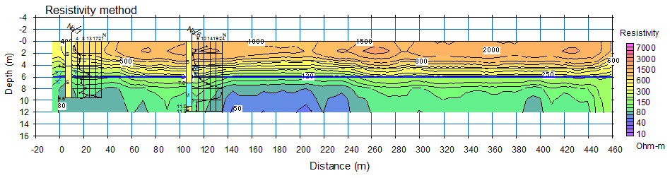
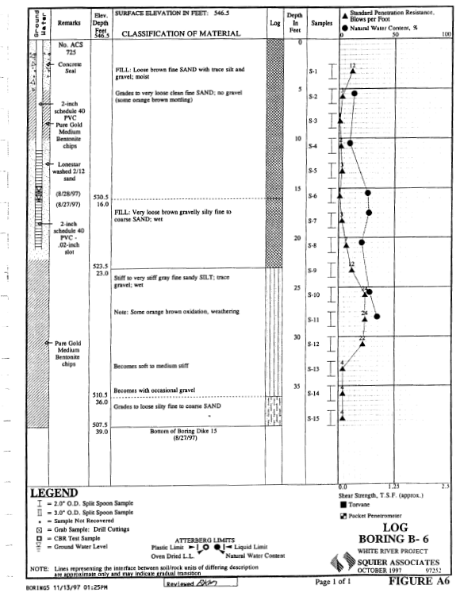
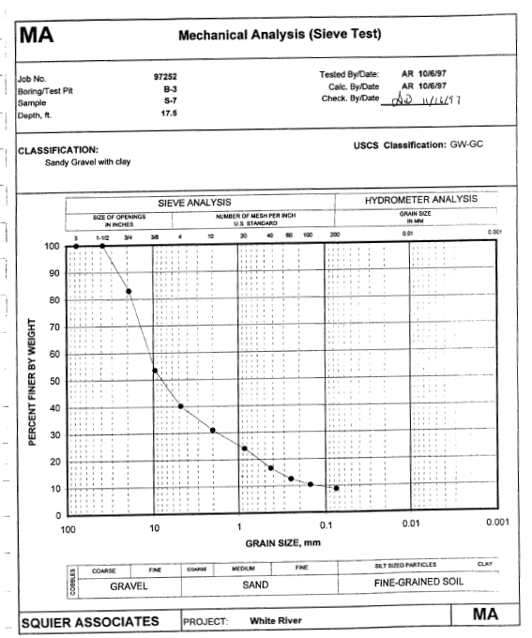
Combine methods with different resolutions and dimensions
Geophysical section
Boring
Laboratory Test
Notes:
Another important concept of the integrated geophysical is combining different methods with different resolution and dimension. This is a resistivity section obtained by the resistivity method.
And we have boring logs.
Clearly the resolution of boring is much better than the geophysical methods and boring gives as much detailed information.
We generally get soil or rock samples from boring and do laboratory tests. This is a grain size distribution. The resolution of laboratory tests is much better than boring and it gives us much detailed information.
Question is which method is best?
There is no answer.
We have to combine all together.

Slide 7
Case Studies
Levee investigations after East Japan Earthquake 2011
Lake Tapps, WA.
Sacrament Delta, CA
New Orleans, LA

Slide 8
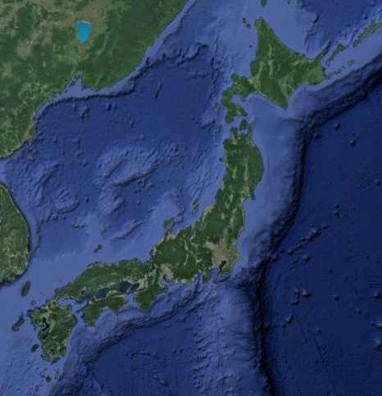
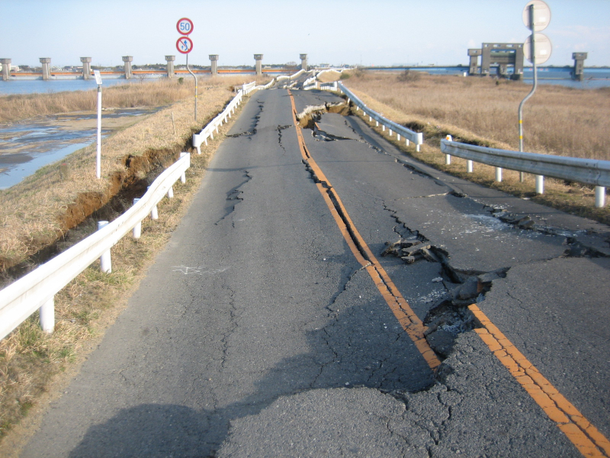
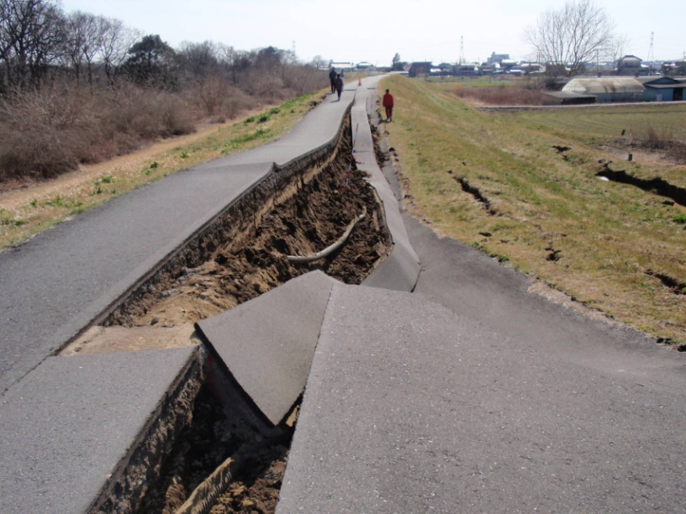
East Japan Earthquake and levee collapse (2011)
2011 Earthquake
Kanto plain
200km
Need to detect damaged levees without visible damage
Notes:
The first example is the levee investigation after 2011 East Japan Earthquake.
The earthquake occurred 2011, magnitude was 9. The Kanto plain is several hundred kilometers away from ruptured area.
Many levees were damaged.
Like these photos.
The problem is the levee loosened or damaged by the earthquake without visible damage.

Slide 9
Need to Detect Damaged Levees without Visible Damage
Before the earthquake
After the earthquake
Loosened
Damaged
Subsidence by liquefaction
Geophysical methods were applied to levees to detect damaged levees

Slide 10
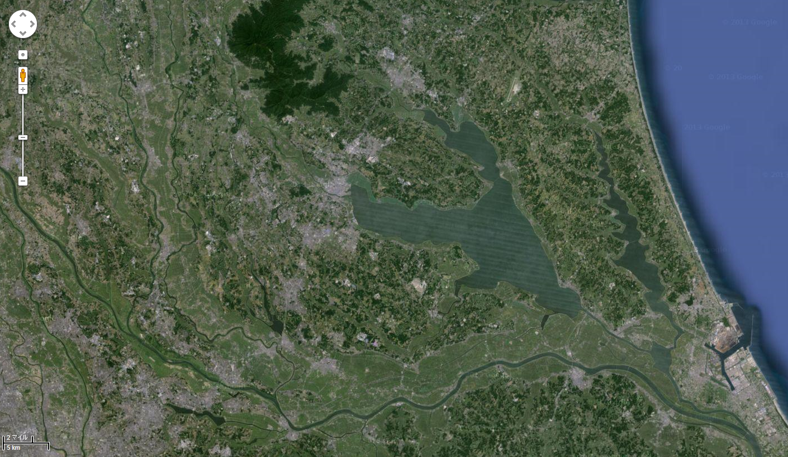
Integrated Geophysical Method for evaluation of levee damage
Survey line length = 160km
5km
Notes:
This is a north-east portion of Kanto area.
We applied the integrated geophysical method to many levees in the area. Yellow lines are survey lines.
Total length of investigated levees was 160km.

Slide 11
Data example
S-wave velocity
Levee body
Foundation
Resistivity
Levee body
A database of the results from 160km of geophysical sections with boring logs was used for statistical analysis
Foundation
Notes:
These are examples of sections, S-wave velocity
and resistivity sections. This is only 1km and we have 160 km similar geophysical sections in this project.
We put all 160km of geophysical sections together with bring logs to database in order to perform statistical analysis.

Slide 12
S-wave velocity and resistivity for levee safety
From the modified Archie’s equation, the resistivity of soil mainly indicates the soil type.
S-wave velocity is mainly affected by the stiffness or porosity.
The safety of levees can be evaluated by the S-wave velocity and resistivity.
Resistivity
Resistivity
High
Soil type
High
Danger (soft, loose, sandy, gravel)
Sand, Gravel
Large permeability
Stiffness
(degree of compaction)
Safety
Small
permeability
Low
(soft, loose)
High
(hard, tight)
Clay, Silt
Safe (hard, tight, silty, clayey )
Low
Low
Low
High
Low
High
S-wave velocity
S-wave velocity
Notes:
This is a concept of levee safety evaluation based on S-wave velocity and resistivity.
From the modified Archie’s equation, resistivity of soil mainly indicates soil type.
High resistivity indicates sand or gravel and low resistivity indicates silt or clay.
S-wave velocity is mainly affected by shear strength or porosity.
High S-wave velocity indicates hard ground and low S-wave velocity indicates soft and loose ground.
From the levee safety point of view, loose, soft and sandy or gravel levee is more danger than hard, tight and silty, clay levees.
Safety of levees can be evaluated by S-wave velocity and resistivity.

Slide 13
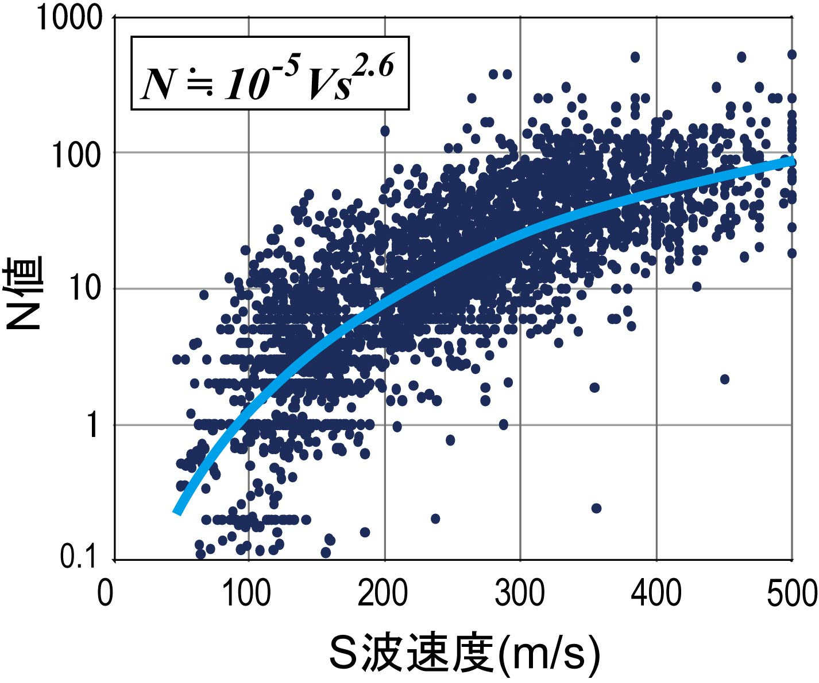
Vs, resistivity, in-situ and laboratory tests
Gravel
Sand
N<3
N-Value (SPT)
Sand and gravel
Clay
135m/s
ρ>200 ohm-m
S-wave velocity (m/s)
Notes:
I will show some examples of the statistical analysis using the database.
This is a relationship between S-wave velocity and N-Value obtained from the standard penetrating tests. In Japan, the N-value has been conventionally used in levee safety evaluation and the relationship between S-wave velocity and N-Value is very important.
For example, N-value less than 3 is usually considered as very loose soil. From this relationship, we define that S-wave velocity less than 135m/sec is loose soil.
This is a relationship between resistivity and 20 % grain size.
Color represents soil type, and blue, yellow and orange indicate clay, sand and gravel respectively.
From rule of thumb, we defined that the soil its 20% grain size is larger the 0.03mm is sand and gravel. It corresponds to the resistivity of 200 ohm-m. Then, we will use the S-wave velocity of 135m/sec and the resistivity of 200 ohm-m for levee safety evaluation.

Slide 14
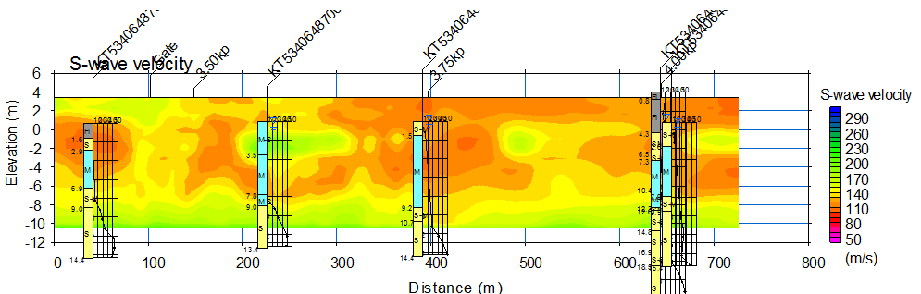
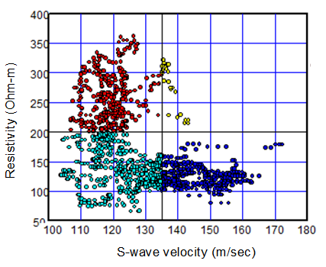
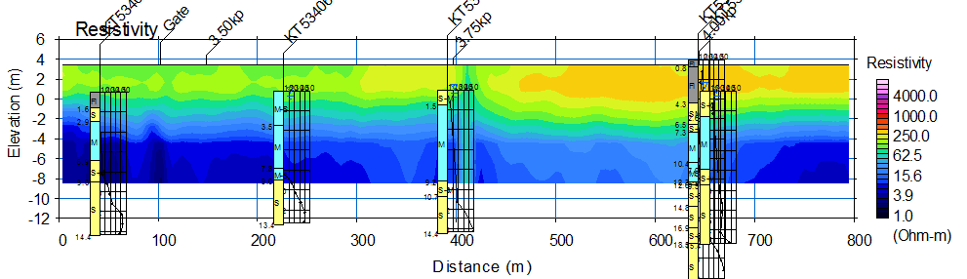
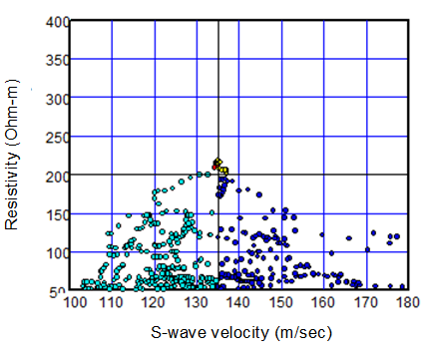
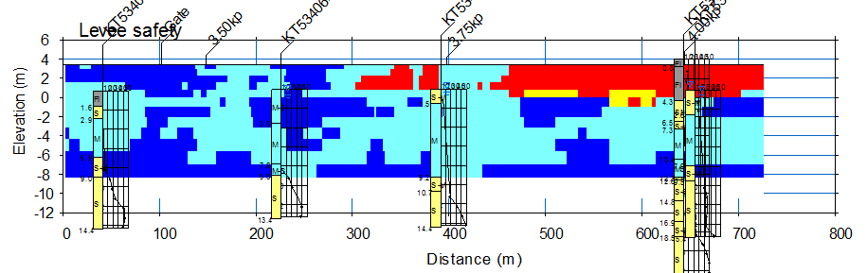
Cross-plot analysis
S-wave velocity
Above groundwater
Resistivity
Below groundwater
Dangerous
Notes:
This is an example of actual processing. At first, we have S-wave velocity and resistivity sections.
Next, we made cross-plots of S-wave velocity and resistivity. Sometimes, we divide data into two groups, above and below ground water, because groundwater may have large effect on the resistivity.
We set the thresholds and evaluate the safety of levee from geotechnical point of view.
Finally, we return the data on the cross-plots to the section.
These red areas are relatively danger compared with rest of section.

Slide 15
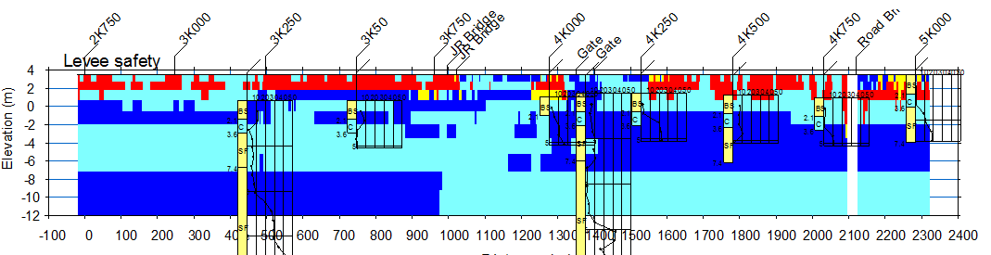
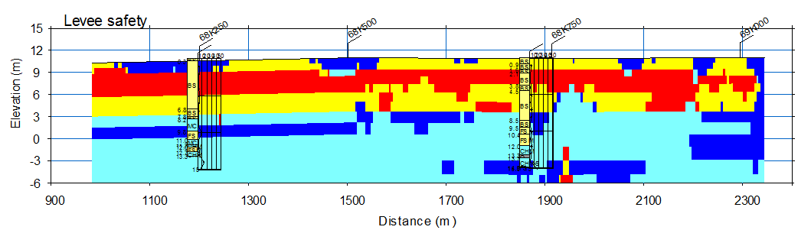
Integrated Geophysical Method for evaluation of levee damage
Survey line length = 160km
Using the Integrated Geophysical Method (including geophysics, borehole data, and levee maintenance records), we could identify the damaged sections from a very long levee.
5km
Notes:
This is conclusions of our levee safety evaluation. We did 160 km of the integrated geophysical method in Kanto plain.
And select three relatively danger portion, about 4km out of 160km based on cross-plot analysis.
This one, about the 500m of levee is danger.
This one about 2km.
And this one, about 1.5km.
In conclusion, we could select relatively danger portion from very long levee using the integrated geophysical method. I would like to note that, this is not only from geophysics. We drew this conclusion together with borehole data, laboratory tests and levee maintenance record as well.

Slide 16
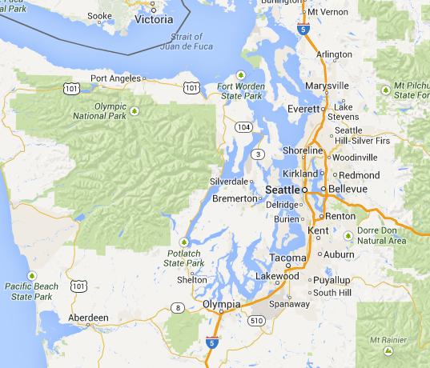
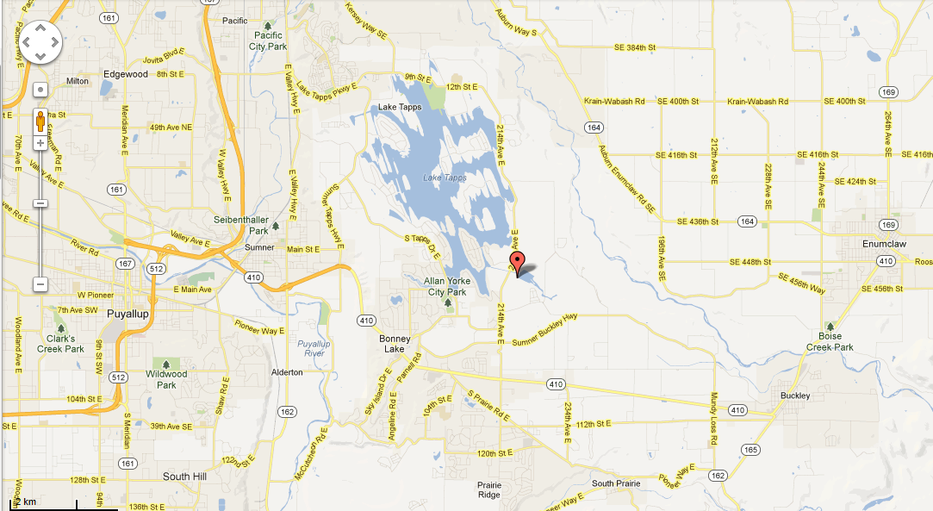
Investigation Site
Integrated geophysical method was applied at a dam site in Lake Tapps, near Tacoma, Washington, to demonstrate the viability of the method.
Lake Tapps
Site of investigation
50km
Notes:
The Lake Tapps, near Tacoma, Washington, is a reservoir that is about 12 km² in surface area and has about 72 km of shoreline (Figure 1). It was created in 1911.

Slide 17
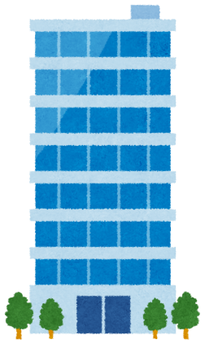

Purpose of Investigation
Series of Dikes
City of Tacoma
The earthquake response of dam.
Stiffness (S-wave velocity)?
Soil type ?
Ground water ?
Liquefaction ?

Slide 18
Example of Integrated Geophysical Method
Resistivity
S-wave velocity
P-wave velocity
Notes:
I will compare three sections obtained by geophysical methods. This is a resistivity section. Resistivity model is 2 layer model. Top layer is high resistivity and bottom layer is low resistivity.
This is an S-wave section obtained by a surface-wave method. S-wave velocity model is also 2 layer model and top layer is low velocity and bottom layer is high velocity. Layer boundary depth is not same as resistivity model.
This is a P-wave section obtained by a refraction method. P-wave velocity of the bottom layer is approximately 1500m/sec and it seems to be ground water level. Layer boundary depths of resistivity and P-wave velocity are almost identical and it seems that the difference of resistivity is mainly due to the water saturation. In this figure, existed boring columns are also shown.

Slide 19
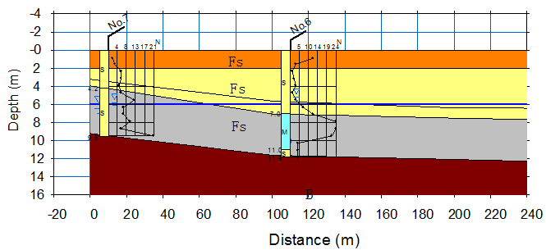
Estimated soil conditions
Depth (m) | P-wave velocity(m/sec) Groundwater | S-wave velocity (m/sec) | Resistivity (ohm-m) | Blow counts | Estimated soil type
0 to 2 | Unsaturated | 120 to 180 | 1000 to 2000 | 1 to 3 | Loose sand with gravel (Upper fill)
2 to 6 | Unsaturated | 180 to 260 | 300 to 1000 | 3 to 10 | Compacted sand with gravel (Upper fill)
6 to 8 | Saturated | 180 to 260 | 300 to 1000 | 3 to 10 | Compacted sand with gravel (Lower fill)
8 to 12 | Saturated | 260 to 300 | 100 to 300 | 5 to 30 | Stiff sandy silt with sand and gravel (Foundation)
Loose sand & gravel
Compacted sand & gravel
Stiff sandy silt with
sand & gravel
Liquefaction is generally occurred where S-wave velocity is less than 200m/sec and second to fourth layers have no significant danger for the liquefaction.
Notes:
This is an example of interpretation. This is a depth. From P-wave velocity, groundwater level was estimated at the depth of 6m. From S-wave velocity, we can recognize stiffness is increasing with depth. As mentioned before, difference of resistivity is primarily related to ground water level. The last column is estimated soil type. We can recognize that, groundwater level, stiffness and soil type were estimated from, P-wave velocity, S-wave velocity and resistivity.

Slide 20
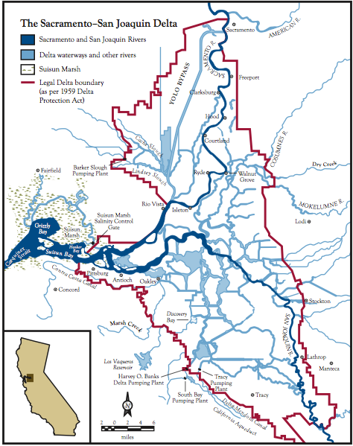
Levee Investigation in Sacramento Delta
Notes:
The Sacramento-San Joaquin Delta is located in the Great Valley of California and drains the Sacramento and San Joaquin Rivers through the Carquinez Strait to the San Francisco Bay.
The Delta is uniquely landlocked, creating an inverted delta system. A traditional river delta is where a single river diverges into many smaller channels on its journey to the ocean whereas an inverted river delta is where two rivers converge and are forced through a single channel.
The modern Delta serves as a source of fresh water for the rest of the state, which is pumped mostly to central and southern California. Two-thirds of California’s population (more than 20 million people) gets at least some of their drinking water from the Delta and its levee system. Plus supplying water to the Great Valley agriculture

Slide 21
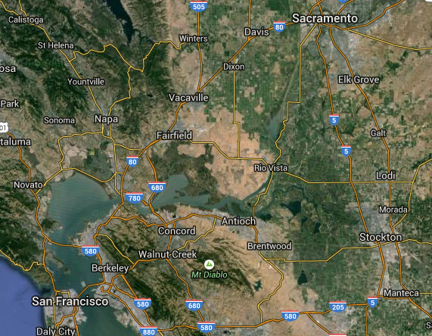
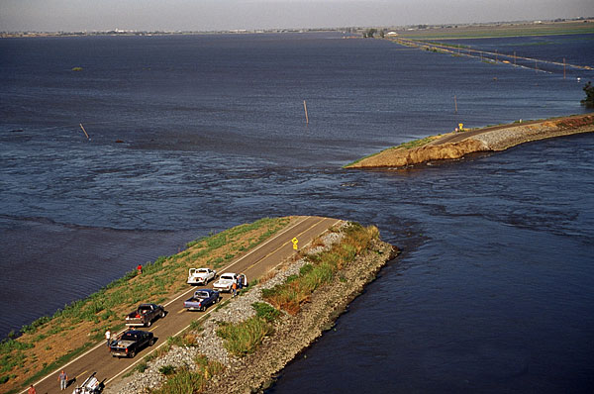
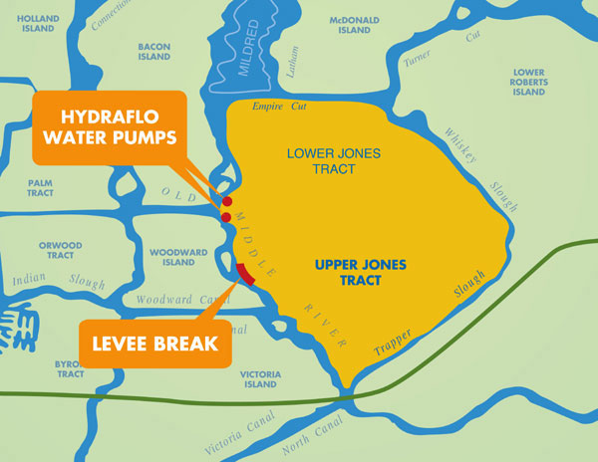
Levee Break in Sacramento Delta
Unexplained failure of the Jones Tract levee in June 2004 exposed the vulnerability of delta levees

Slide 22
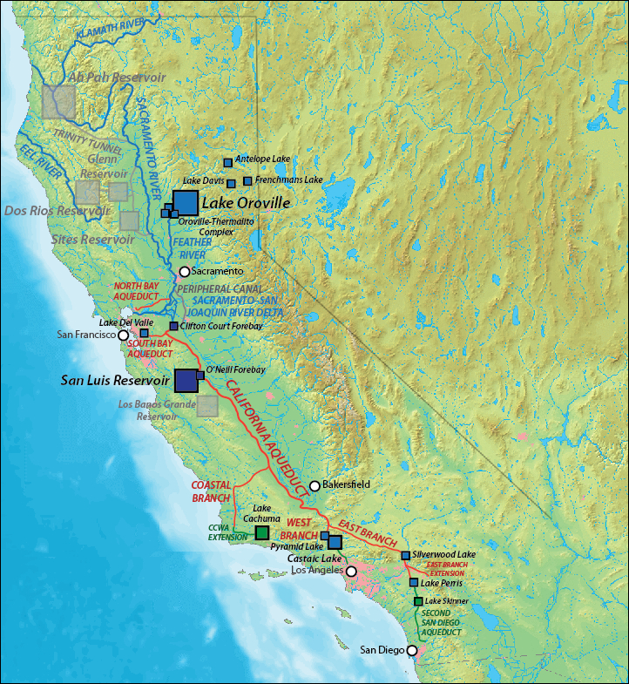
The Delta serves as a source of fresh water for the rest of the state, which is pumped mostly to central and southern California. Two-thirds of California’s population (more than 20 million people) gets at least some of their drinking water from the Delta and its levee system.
In order to estimate seismic risk for the region and its levee system, S-wave velocity was measured at numerous sites in the Delta.
Notes:
CA State Water Project-The vast majority of the SWP water is drawn through the Delta's complex estuary system into the Clifton Court Forebay
___
Blue squares: existing SWP reservoirs
Red lines: existing SWP canals, tunnels and aqueducts
Blue lines: rivers and natural waterways
Dark blue squares: SWP reservoirs shared with w:Central Valley Project
Light gray squares and lines: Unbuilt reservoirs and canals originally planned under SWP
Green squares and lines: Non-SWP distribution infrastructure supplied by SWP water

Slide 23
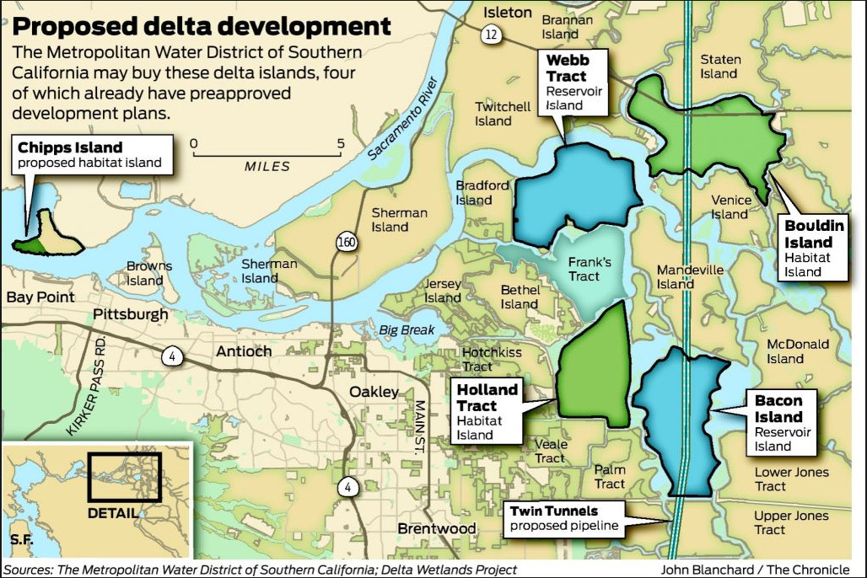
Proposed Aqueduct
Delta Tunnels
Bay Delta Conservation Plan / California WaterFix
Capable of diverting 9,000 cfs from north Delta
Could have major environmental impact

Slide 24
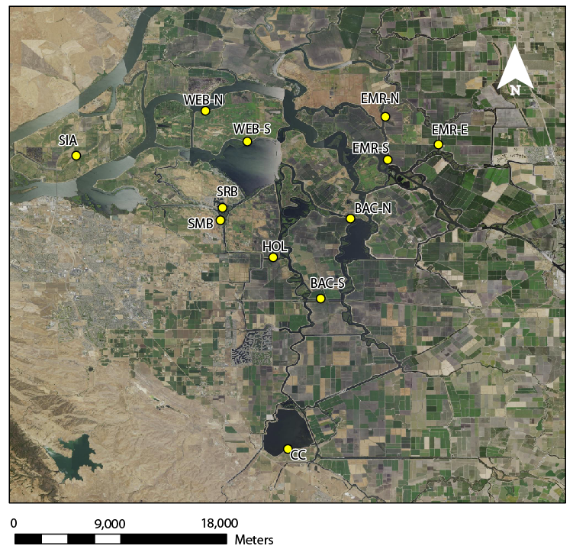
Delta Surface Wave Survey Locations
Notes:
We conducted 12 seismic surveys in the Delta trying to get a good coverage of region, ease of access and could obtain permission to use land. Our site spacing is approximately 2-~20km.
Some locations were easier than others. On Webb Tract, we needed to take a small car ferry to the sites.
The twelve sites are:
Sherman Island (SIA) –USGS Station
Webb Tract-North (WEB-N)
Webb Tract-South (WEB-S)
Bethel Island (SRB)-USGS station
Hotchkiss Tract-Sand Mound Boulevard (SMB)-USGS Station
Holland Tract (HOL) –USGS Station
Bacon Island-North
Bacon Island-South
Empire Tract-North-USGS station
Empire Tract-South
Empire Tract-Empire
Clifton Court Forebay
We conducted two types of Surface wave surveys in the Delta. One active source survey with a sledgehammer impact source and the other survey with ambient sources such as wind, water waves, traffic etc.

Slide 25
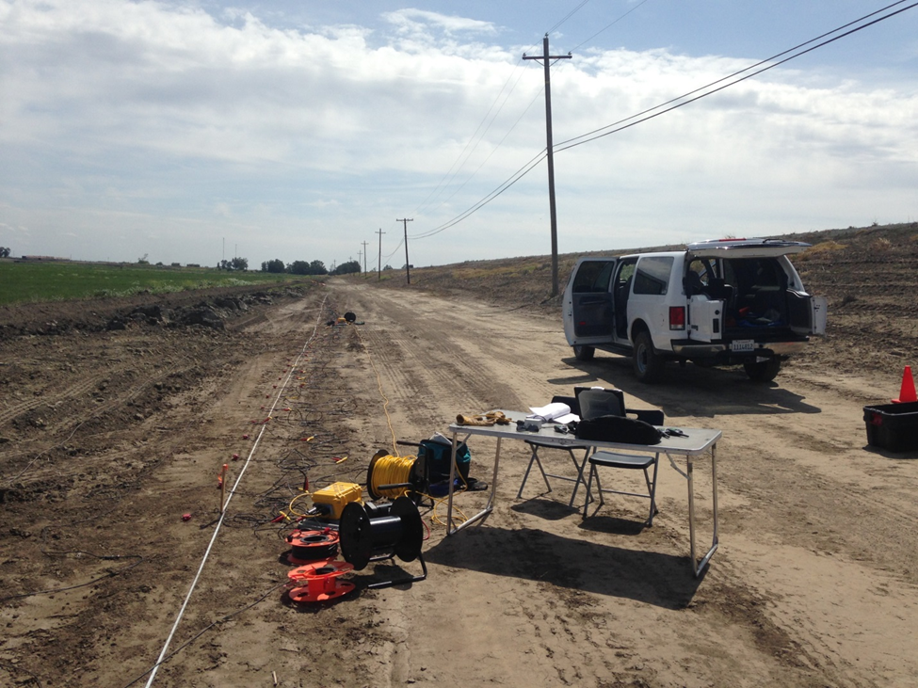
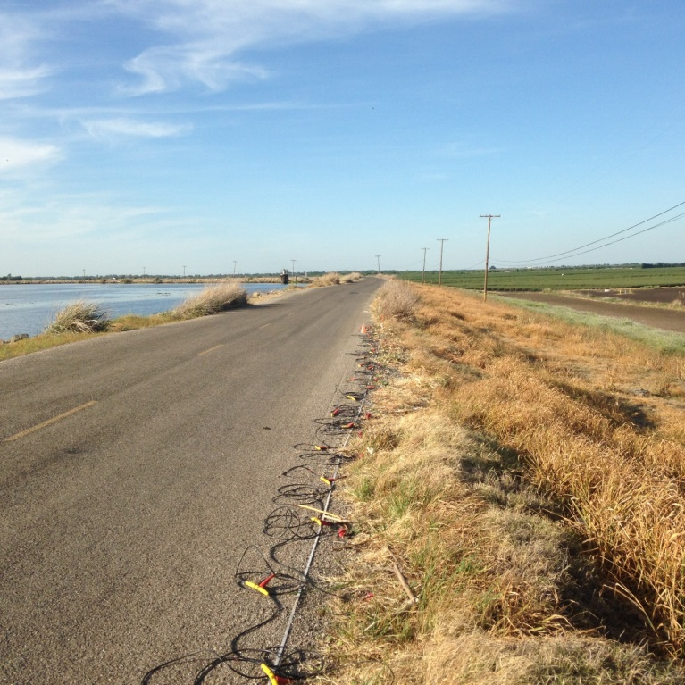
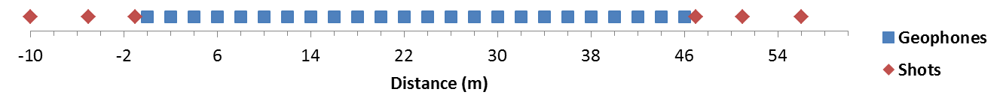
Seismic Data Recording Setup
Bacon Island South (BAC-S)
Setup off of levee.
Empire Tract (EMR-S)
Setup on crown of levee.
Notes:
Here are two examples of our site location and equipment setup for each of the surveys.
On the left is a site off the levee out on Bacon Island. This is the south site. Here’s our vehicle and equipment. You can see the levee here. For some of the sites, this one included we’d be driving on top of the levee. This levee had access roads to the farmlands so we were able to setup below it. The water level is about here. Levees throughout the Delta were between 8 and 25 ft. tall depending on location.
You can see our office setup here. Our geophone spread heading down the line. Here’s our geode seismograph with spread cable, network cable and trigger cable. Not picture is our 10-lb sledgehammer and metal impact plate.
Heres a graph of survey geometry. 47m spread with 1m geophone spacing and offend shots at 1 or 2, 5 and 10m
On the right side is a site on top of the levee on Empire Tract. This is the south site.
We’d record both active and passive data at each site.
Most sites were quiet and the data quality was pretty good. Afternoon winds did cause some noise.

Slide 26
S-wave Velocity Profiles with Borehole Logs
40 m/s
Sites with a peat layer had extremely low values of Vs. Based on soil borings, the thickness of peat layers were approximately 0 to 8 m. The Vs for the peat layers ranged from 40 to 150 m/s while the sand layer exhibited Vs ranging from of 220 to 370 m/s. Soft near surface soils in the region pose an increased seismic hazard due to the potential for high ground accelerations.

Slide 27
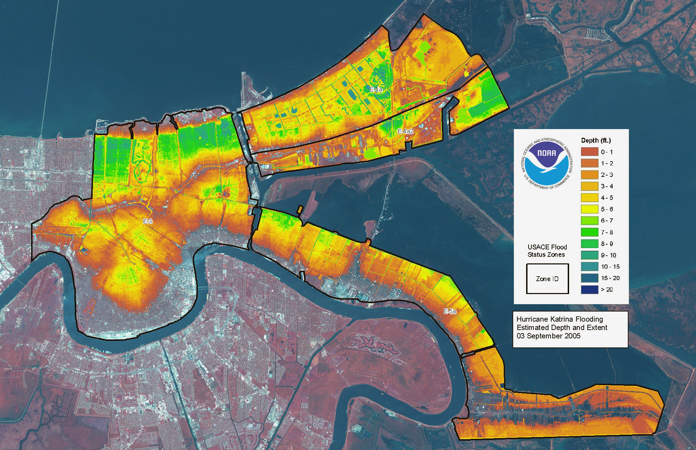
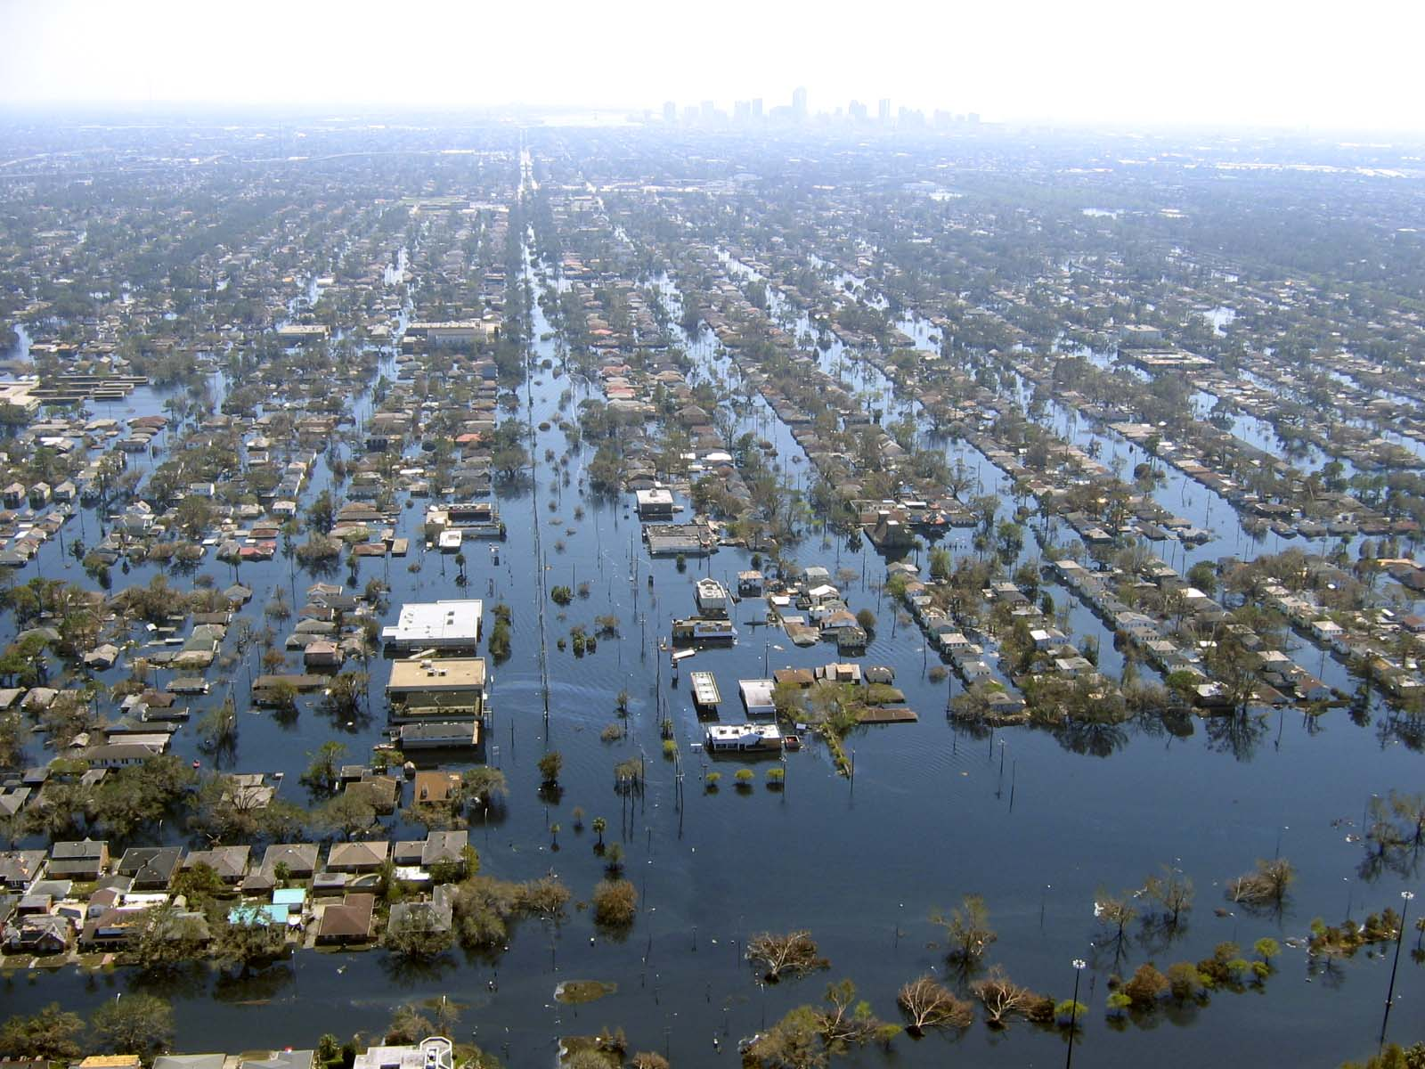
Hurricane Katrina (2005)
Flooding depth
in New Orleans
Depth (m)
London Avenue Canal
0.5
1.0
2.0
3.0
>5.0
http://www.noaanews.noaa.gov/stories2005/images/katrina-flood-depth-estimation-09-03-2005.jpg
Notes:
I will introduce an example how near-surface geophysics relates to our society. In 2005, the Hurricane Katrina hit New Orleans and killed more than 2,500 people. Most of damages from the Hurricane were due to flooding. This is flooding depth in New Orleans. We can see that the large area of New Orleans was flooded more than 2m of water. The city of New Orleans is protected by many levees along the Mississippi River and adjacent canals. During the Hurricane Katrina, the levees were collapsed at several places.
For example, a levee was collapsed at London Avenue canal and it cause serious flooding at residential area.

Slide 28
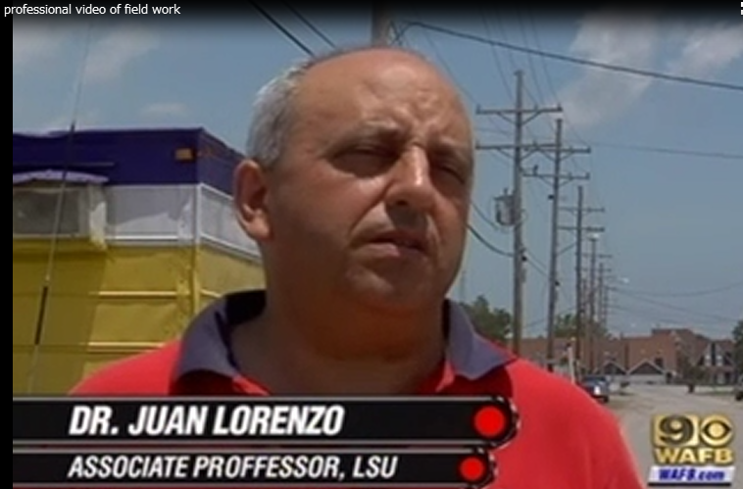
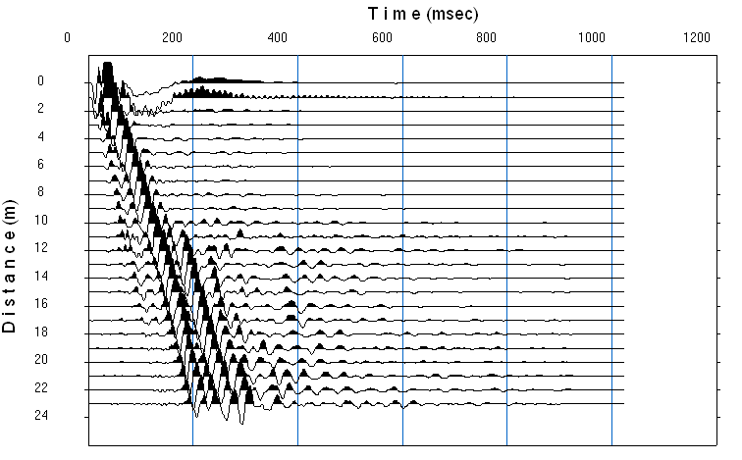
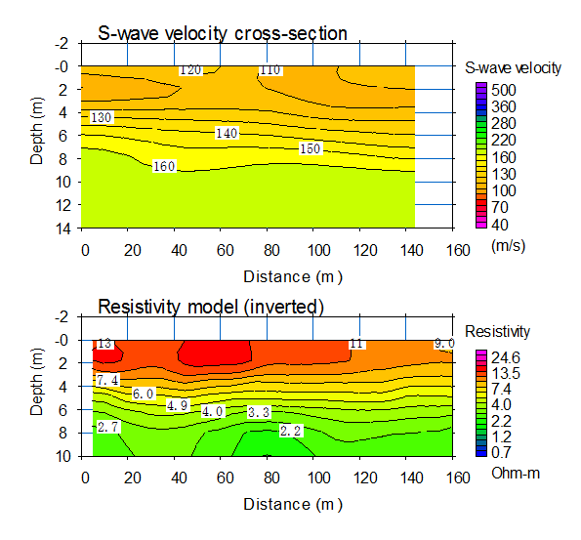
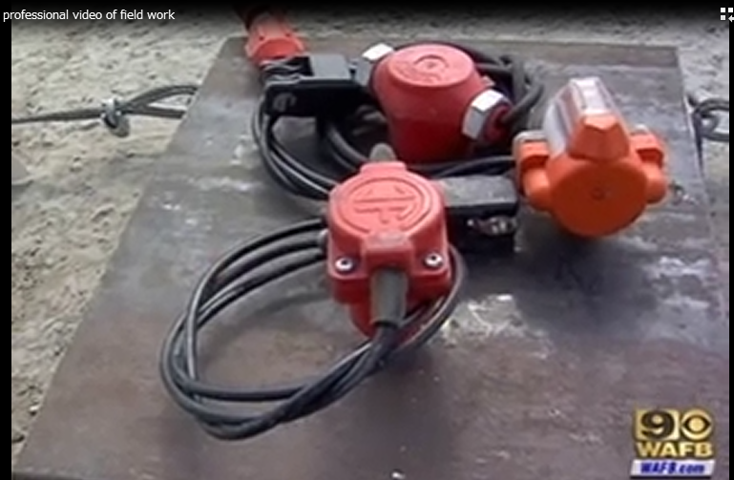
Levee break in New Orleans
Water level
at the levee collapse
Concrete slab
Turnover
Sheet pile
Sand layer
Boiling
Notes:
The levee at the London Avenue canal broke before water reached top of the levee. The question is why did the levee break? There is a soft sand layer beneath the levee at the London Avenue canal. As water level rose, water pressure in that sand layer increased to the point where that sand layer could not bear the levee. And eventually break caused serious flooding. Is there something that near-surface geophysics can contribute to protect the City of New Orleans from flooding? The answer is yes. Near-surface geophysics can detect the soft sand layers that may cause levees to break. Geophysicists at Louisiana State University performed seismic and resistivity surveys along the canal and S-wave velocity and resistivity sections were obtained. These geophysical sections can show soft sand layers in order to establish a stronger levee system at the City of New Orleans.

Slide 29
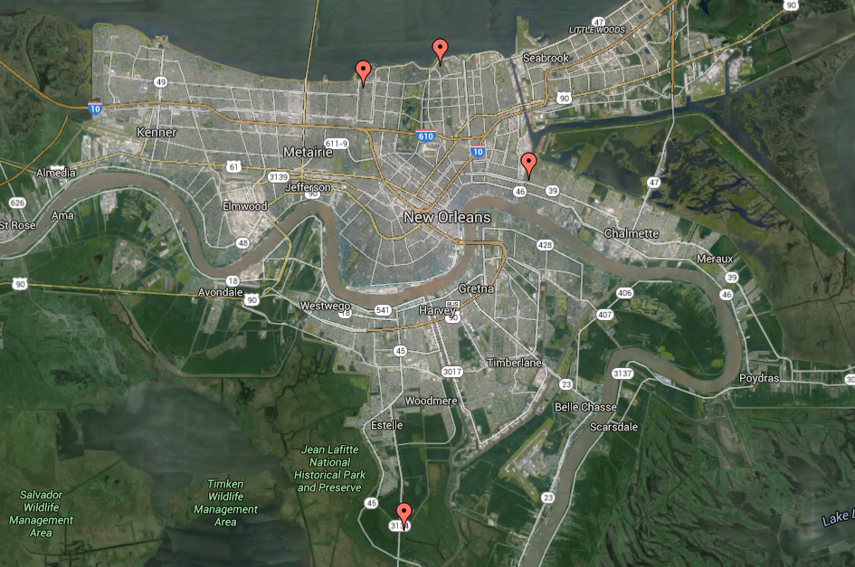
Levee Investigation in New Orleans

Slide 30
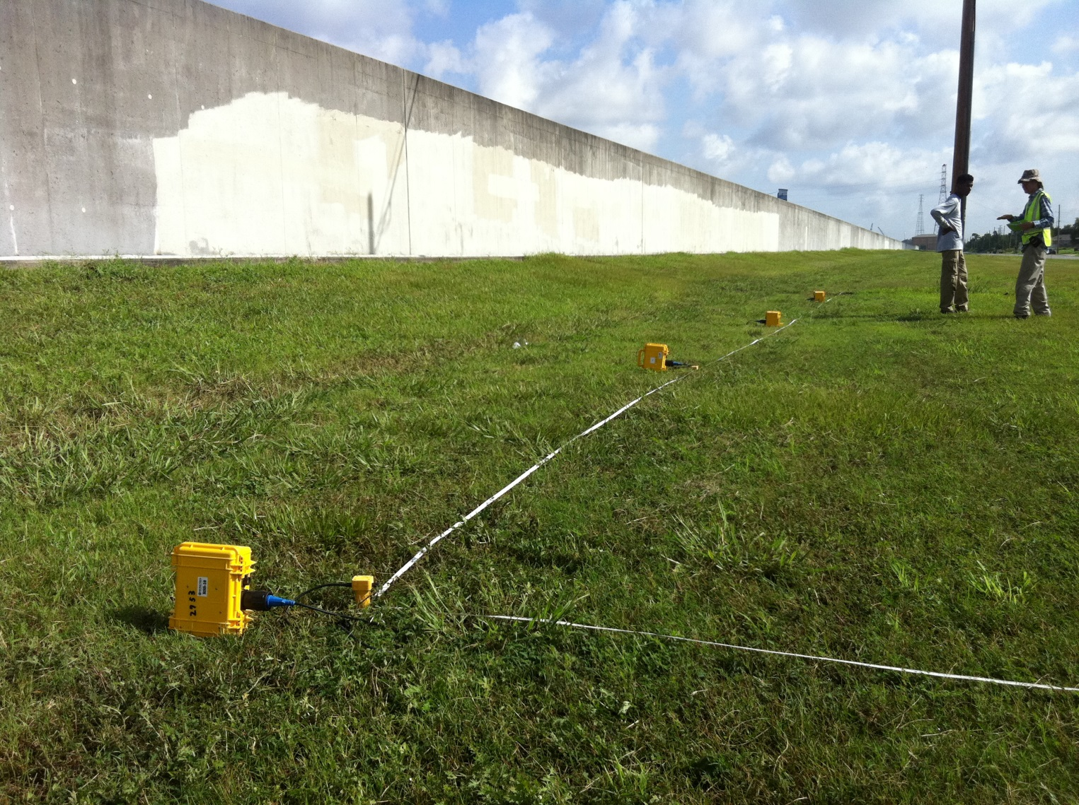
Lower 9th Ward
Levee broken by Katrina and reconstructed

Slide 31
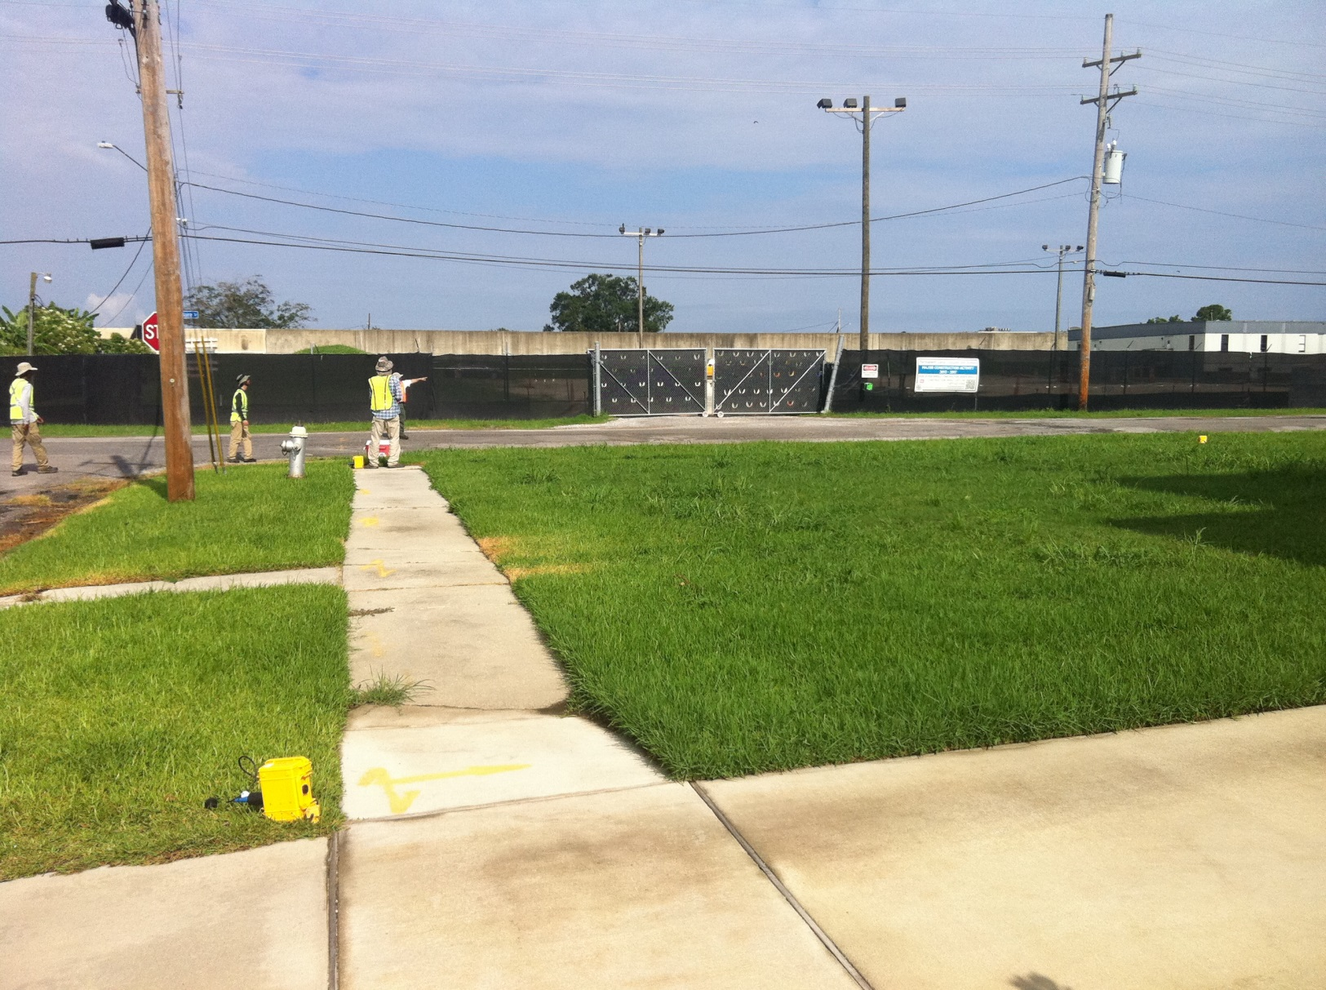
17th Street Canal
Old levee
Levee broken by Katrina and reconstructed

Slide 32
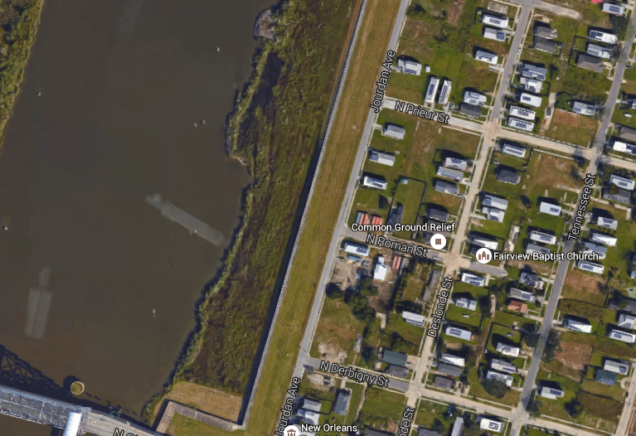
Geometry Example (Lower 9th Ward)
240m
60m
15m

Slide 33
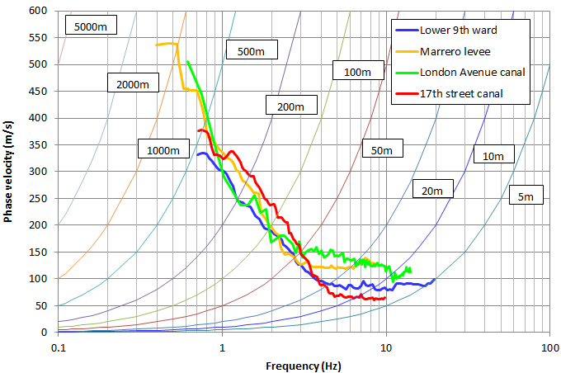
Comparison of dispersion curves

Slide 34
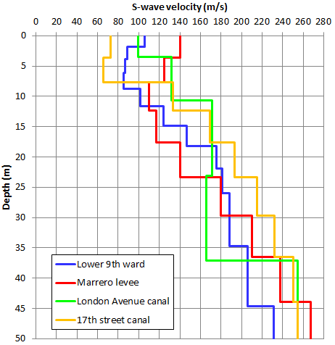
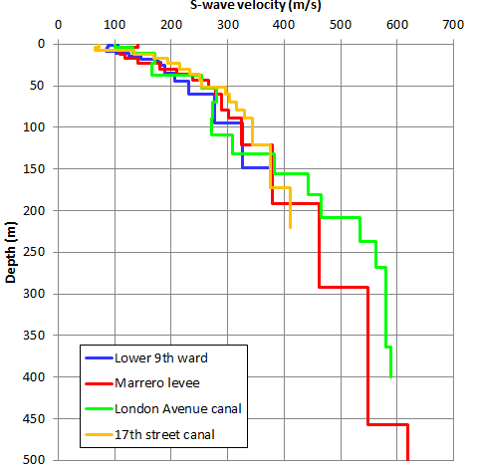
Comparison of velocity models

Slide 35
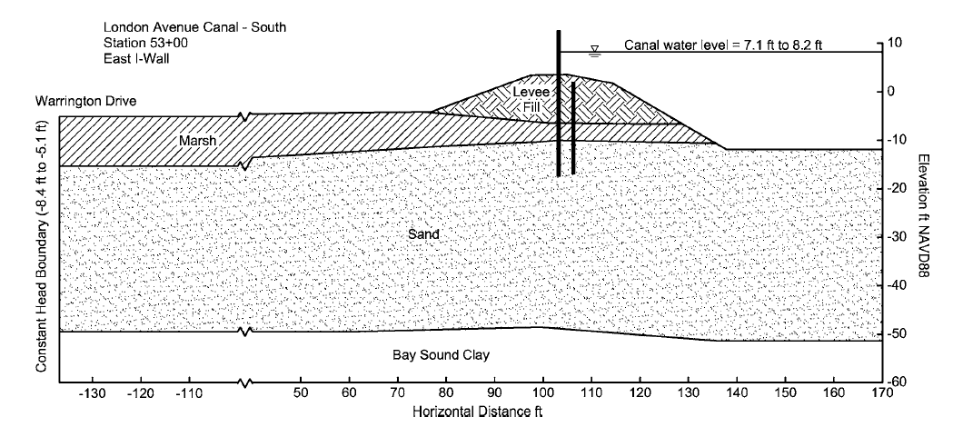
London Avenue Canal
S-wave velocity of the sand layer caused levee breach indicates loosen sand.

Slide 36
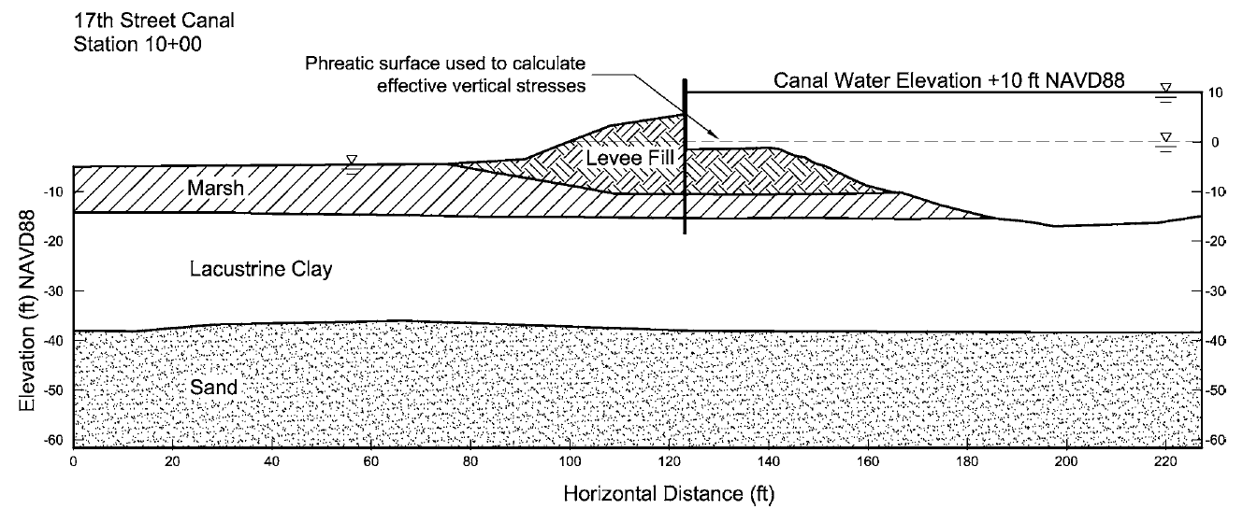
17th Street Canal
S-wave velocity of the clay layer caused levee breach is extremely slow.

Slide 37
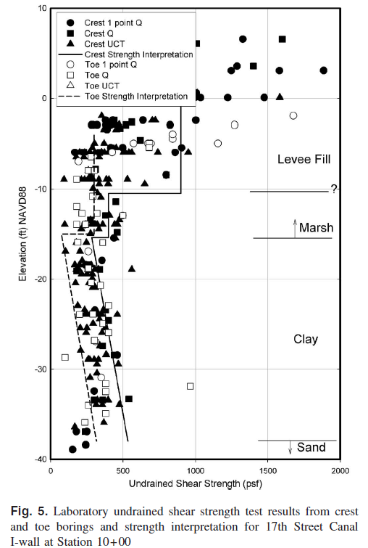
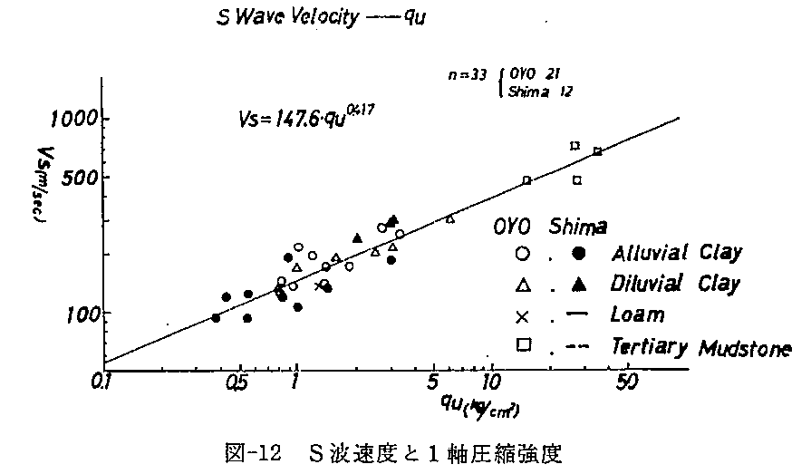
17th Street Canal
Comparison of undrained shear strength (S_{u}) empirically calculated from S-wave velocity (V_{s})
S-wave velocity (m/s) and unconfined compression strength (q_{u}(kg/cm²))
Undrained shear strength obtained by S-wave velocity is generally consistent with the laboratory tests

Slide 38
Conclusions
Q : How do we apply geophysical methods to levee safety assessment ?
A : Geophysical methods are one of the investigation tools. Combine or integrate with different methods.
Visual inspection
Geophysical methods do not replace other methods. Combine or integrate with different methods.
Maintenance record
Boring
CPT
Geophysical methods
Low resolution, continuous, non-invasive

Slide 39

Thank you very much !

