Slide 1
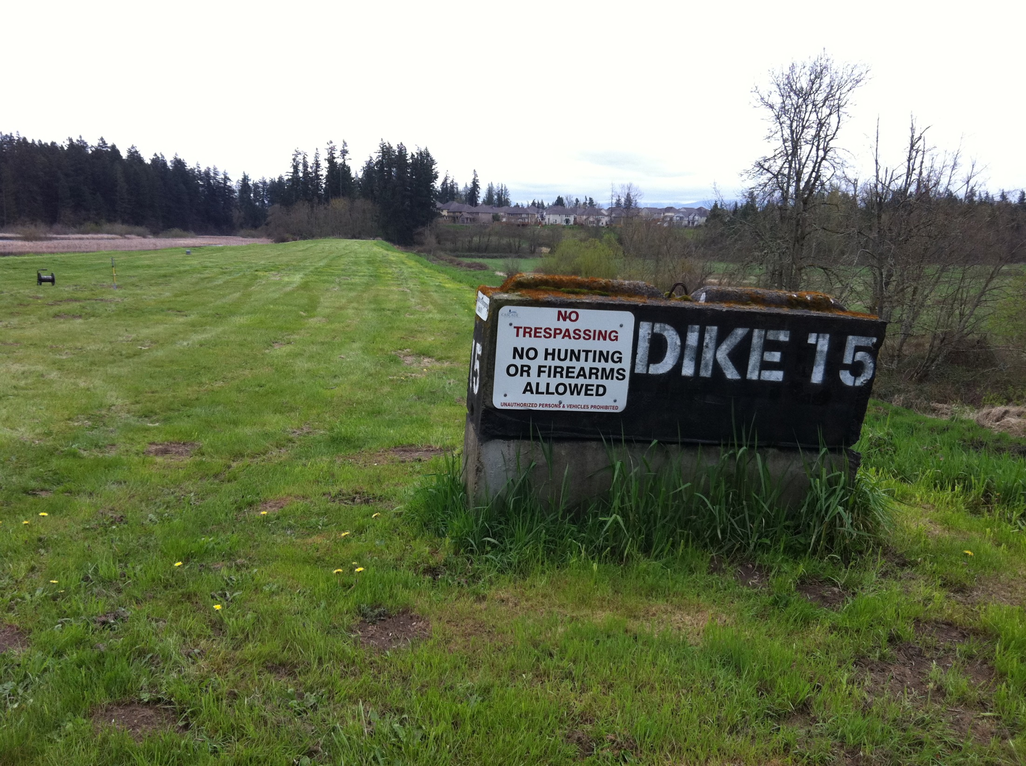
A Safety Evaluation of Dams Using Integrated Geophysical Method :
A Case Study in Washington State
*Koichi Hayashi (Geometrics)
Recep Cakir (DNR, WA)
Timothy J. Walsh (DNR, WA)
Jerald LaVassar (Department of Ecology, WA)

Slide 2
Introduction
The earthquake response of dams is an important part of safety evaluations of impoundments in the United States.
Conventional dam investigations use invasive borings that are expensive and often do not adequately capture the variance in subsurface conditions in heterogeneous sites.
Non-invasive, rapid, and spatially continuous investigation methods are needed to augment conventional investigation techniques.
Recently, geophysical methods have made remarkable progress as computing power and speed increase and electronic instruments gain in sensitivity.
Considering such progress, geophysical methods can play an important role in dam investigations in such areas as characterizing shear moduli and types of soils.

Slide 3
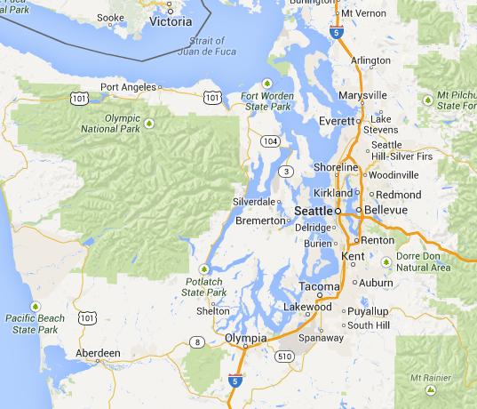
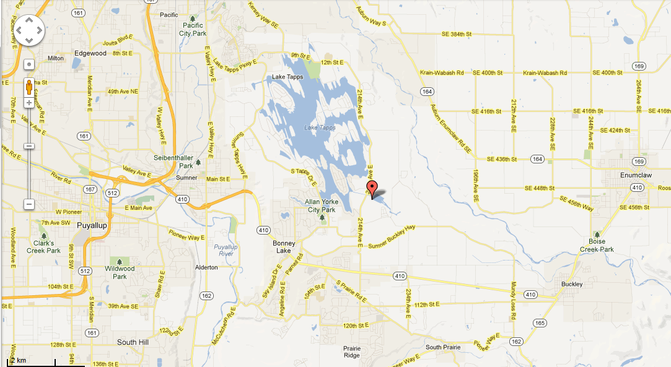
Investigation Site
Integrated geophysical method was applied at a dam site in Lake Tapps, near Tacoma, Washington, to demonstrate the viability of the method.
Lake Tapps
Site of investigation
50km
Notes:
The Lake Tapps, near Tacoma, Washington, is a reservoir that is about 12 km² in surface area and has about 72 km of shoreline (Figure 1). It was created in 1911.

Slide 4
Investigation Site and Data Acquisition
Seismic refraction method
(P-wave velocity)
Active surface wave method
(S-wave velocity)
Resistivity method (Resistivity)
Linear passive surface wave method
(deep S-wave velocity)
2 station passive surface wave method
(deeper S-wave velocity)

Slide 5
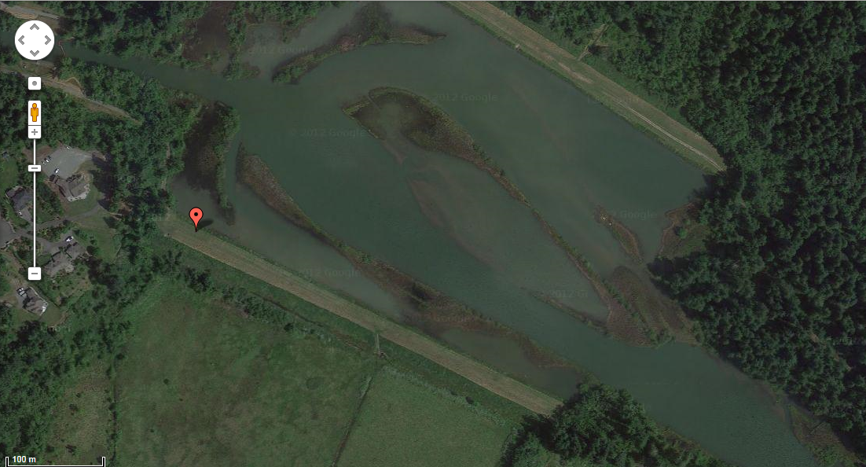
Survey Line
The dam is about 450m long and 7m high.
0m
450m

Slide 6
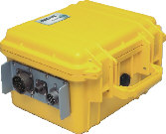
Data acquisition for the surface-wave method
Data acquisition
Shot mark
Short wavelength surface waves
Seismograph
Spread cables
Receivers
Long wavelength surface wave
Notes:
Here is the data acquisition of seismic methods. 24 channel Geode is used for seismograph. We used 4.5Hz geophones for receiver and a sledge hammer for source. Same equipment was used for the data acquisition of refraction and linear array passive method as well.

Slide 7
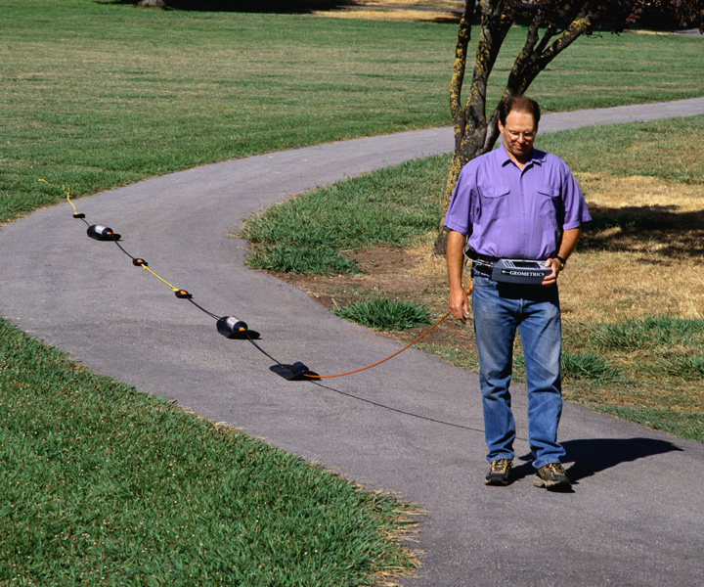
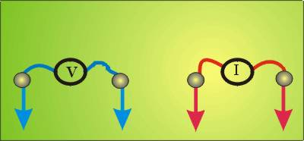
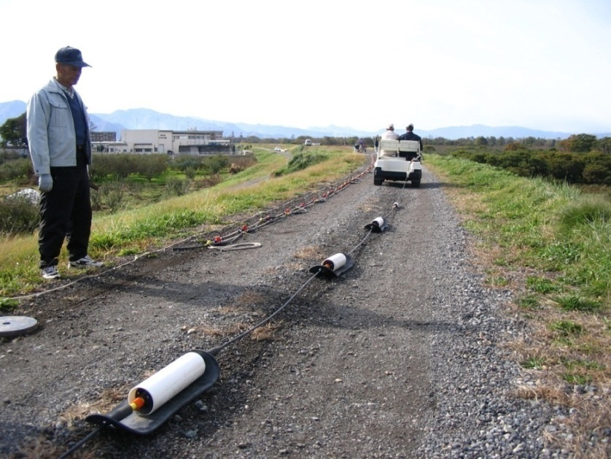
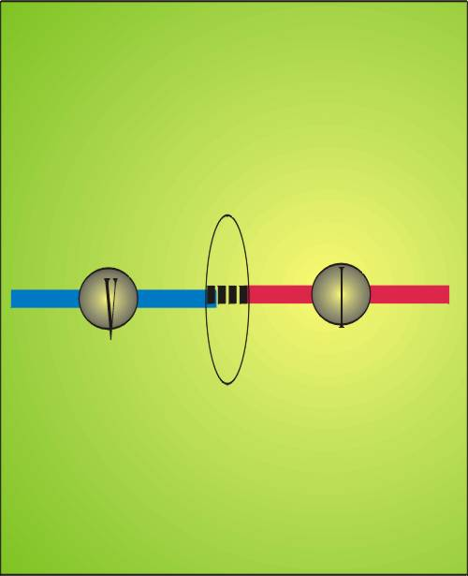
Resistivity Method Using Capacitively Coupled Resistivity (CCR)
In CCR, capacitors are used as electrode and metallic stakes are not used. The OhmMapper was used as a CCR instrument
Notes:
A capacitively-coupled resistivity (CCR) method is a new resistivity method in which capacitors are used as electrodes. Unlike a conventional resistivity method, the CCR method does not use metallic stakes and enables us to measure the resistivity of the ground very quickly. The fundamental principle of capacitive coupling is that AC current will pass through a capacitor. In a CCR instrument, a cable (or metal plate) acts as one half of a capacitor, while the earth functions as the other half. This cable-earth capacitor has a variable capacitance depending on the earth conditions, but an AC current generated by the transmitter will pass from the cable into the ground. At the receiver, the transmitter-generated ground current will generate an AC voltage that is coupled into the CCR receiver and measured. The CCR receiver is conceptually equivalent to an AC Volt meter.

Slide 8
Passive surface wave method using 2 station SPAC
Fixed sensor
5m
10m
15m
20m
Till approximately depth of investigation (400m)
5min.
5min.
Moving sensor
5min.
10min.
Record length increases with sensor spacing increases (5 to 30min.).
Notes:
In the 2 station SPAC method, one sensor was established at a fixed location with microtremor data acquired at this location for the duration of the survey. Microtremor data were acquired with a second sensor using variable station separations ranging from 5m to 400m.

Slide 9
Example of Waveform Data
First arrival picking
Phase velocity analysis
Notes:
Here is an example of seismic waveform data. We used a same shot record for both refraction and surface wave analysis. First arrivals are picked and used for traveltime curve analysis in refraction method. Full waveform is converted into frequency domain and used for phase velocity analysis to generate a dispersion curve.

Slide 10
Traveltime Curves for Refraction Analysis
Refracted arrival
Direct arrival
Notes:
Here is traveltime curves used for refraction analysis. Traveltimes curves imply that two layer model, direct arrival and refracted arrival. In this figure, blue lines are observed data and black lines are theoretical traveltimes calculated from resultant velocity model shown later.

Slide 11
Comparison of 3 Profiles
Resistivity
S-wave velocity
P-wave velocity
Notes:
Here is a comparison of three sections obtained from resistivity method, surface-wave method and refraction method. Resistivity model is 2 layer model. Top layer is high resistivity and bottom layer is low resistivity. S-wave velocity model is also 2 layer model and top layer is low velocity and bottom layer is high velocity. Layer boundary depth is not same as resistivity model. P-wave velocity model is also 2 layer model. Top layer is low velocity and bottom layer is high velocity. P-wave velocity of the bottom layer is approximately 1500m/sec and it seems to be ground water level. Layer boundary depths of resistivity and P-wave velocity is almost identical and it seems that the difference of resistivity is mainly due to the water saturation. In this figure, existed boring columns are also shown.

Slide 12
Dispersion curve
Notes:
Left figure shows the comparison of dispersion curves, obtained by MASW, passive surface wave method using linear array, passive surface wave method using 2 station method. We can see that three dispersion curves agree with each other and the 2 station method yields phase velocity at low frequency region compared with the MASW and the linear array. Right figure shows the comparison of observed and theoretical data calculated from resultant velocity model will be shown next. Red line is observed data and yellow circles are effective mode of theoretical data. The effective mode was calculated as weighted average of fundamental and higher modes up to 5th mode. We can see that the theoretical phase velocities almost agree with observed data.

Slide 13
S-wave velocity model
Shallow region
Deep region
Notes:
Here is the resultant S-wave velocity model. We can see that S-wave velocity down to the depth of 400m was estimated from the passive surface wave method. There are two clear layer boundaries, 10m and 400m. At the depth of 10m, S-wave velocity increase from 200 to 300m/sec. This is the bottom of the dike. Another boundary is at the depth of 400m and S-wave velocity increases from 700m/sec to 1000m/sec. This seems to be bed rock. Bed rock depth is very important for the seismic amplification calculation and this results shows the 2 station method is very effective for the seismic amplification study.

Slide 14
Correlation Between Blow Counts (N) by SPT and S-wave Velocity.
Notes:
Here is the correlation between Blow Counts (N-value) obtained by the standard penetrating test ()SPT and S-wave Velocity obtained by surface wave method. A black line is Imai’s equation obtained by Blow Counts and S-wave velocity obtained by Japanese geotechnical investigation.

Slide 15
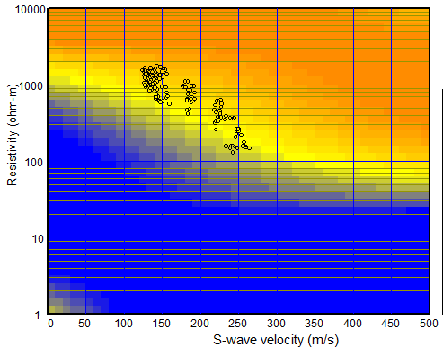
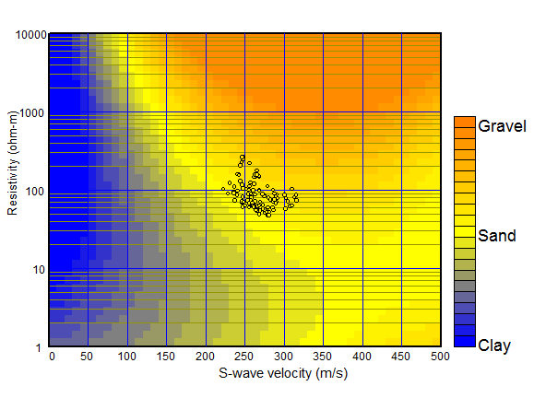
Cross-plot Analysis of
S-wave Velocity and Resistivity
Above Ground Water Level
Below Ground Water Level
Notes:
We tried to estimate soil type statistically from S-wave velocity and resistivity. Here is the cross plot of S-wave velocity and resistivity for above and below groundwater level respectively. Background color indicates empirical relationship or statistical obtained from Japanese levees and blue, yellow and orange colors indicate clay sand and gravel respectively. We can see that Soil type is changing from clay to gravel with S-wave velocity and resistivity increase. Using this chart, we can estimate soil type from S-wave velocity and resistivity.

Slide 16
Soil Classification Based on the Cross Plot of S-wave Velocity and Resistivity
Soil Classification Based on the Cross-plot analysis
Interpretation Based on the Geophysical sections and Soil Classification
Loose sand with gravel (Vs < 200m/sec)
Compacted sand with gravel (Vs > 200m/sec)
Stiff sandy Silt with sand and gravel
Notes:
Section shown at the top is estimated soil type. Soil type is basically sand and top half of dike (surface to depth of 5m) may include coarse sand or gravel compared with and bottom half is more sandy and silty. Estimated soil type is basically consistent of soil columns. Section shown at the bottom is interpreted geological section with drilling logs and geophysical sections. The dike body can be divided into 3 layers.

Slide 17
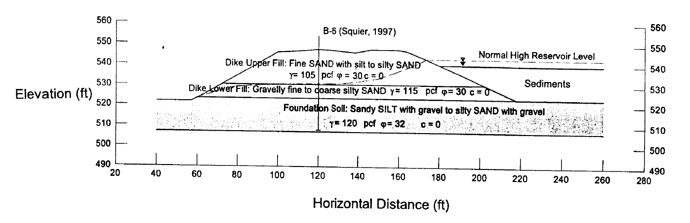
Comparison with
Existed Geological Section
Dike Upper Fill
Dike Lower Fill
Foundation Soil

Slide 18
Estimated Soil Condition
Depth (m) | S-wave velocity (m/sec) | Resistivity (ohm-m) | Blow counts | Groundwater | Estimated soil type
0 to 2 | 120 to 180 | 1000 to 2000 | 1 to 3 | Unsaturated | Loose sand with gravel (Upper fill)
2 to 6 | 180 to 260 | 300 to 1000 | 3 to 10 | Unsaturated | Compacted sand with gravel (Upper fill)
6 to 8 | 180 to 260 | 300 to 1000 | 3 to 10 | Saturated? | Compacted sand with gravel (Lower fill)
8 to 12 | 260 to 300 | 100 to 300 | 5 to 30 | Saturated | Stiff sandy Silt with sand and gravel (Foundation)
Notes:
The table is summary of investigation. The dike body can be divided into 3 layers. Upper two layers seems to be above the ground water.

Slide 19
Discussion
First layer is very loose but its thickness is only 2m.
Second and third layer is well compacted based on the result of surface-wave method although blow counts does not show clear difference between first and second layer.
Fourth layer seems to be silty based on both boring and geophysical methods.
Existed report divided the dike into two layers, upper fill and lower fill.
Geophysical methods imply that the upper fill can be divided into two layers and the lower part of the upper fill seems to be well compacted as the lower fill.
Liquefaction is generally occurred where S-wave velocity is less than 200m/sec and second to fourth layers have no significant danger for the liquefaction.

Slide 20
Conclusions
Resultant geophysical sections were interpreted with the aid of boring logs.
A P-wave velocity section from a refraction method shows groundwater level in the dam.
An S-wave velocity section from a surface-wave method implies a difference of compaction level in the dam fill.
A resistivity section from capacitively coupled resistivity estimates soil type and also groundwater levels in the dam.
A passive surface-wave method showed an S-wave velocity profile to a depth of 400m and intermediate bedrock with the S-wave velocity of 600m/sec was determined at a depth of approximately 250m.

